Slide 1
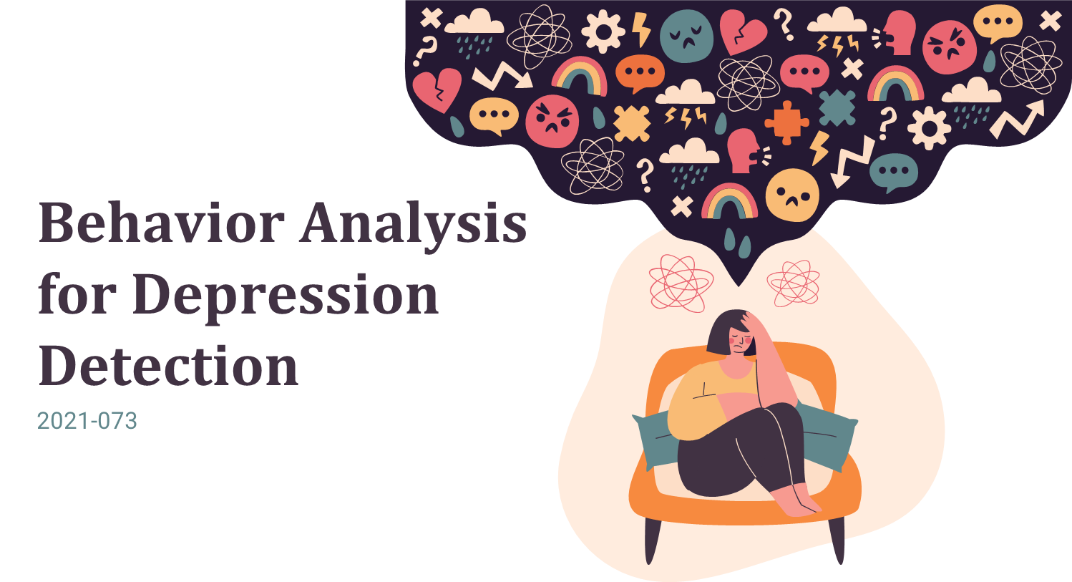


Slide 2

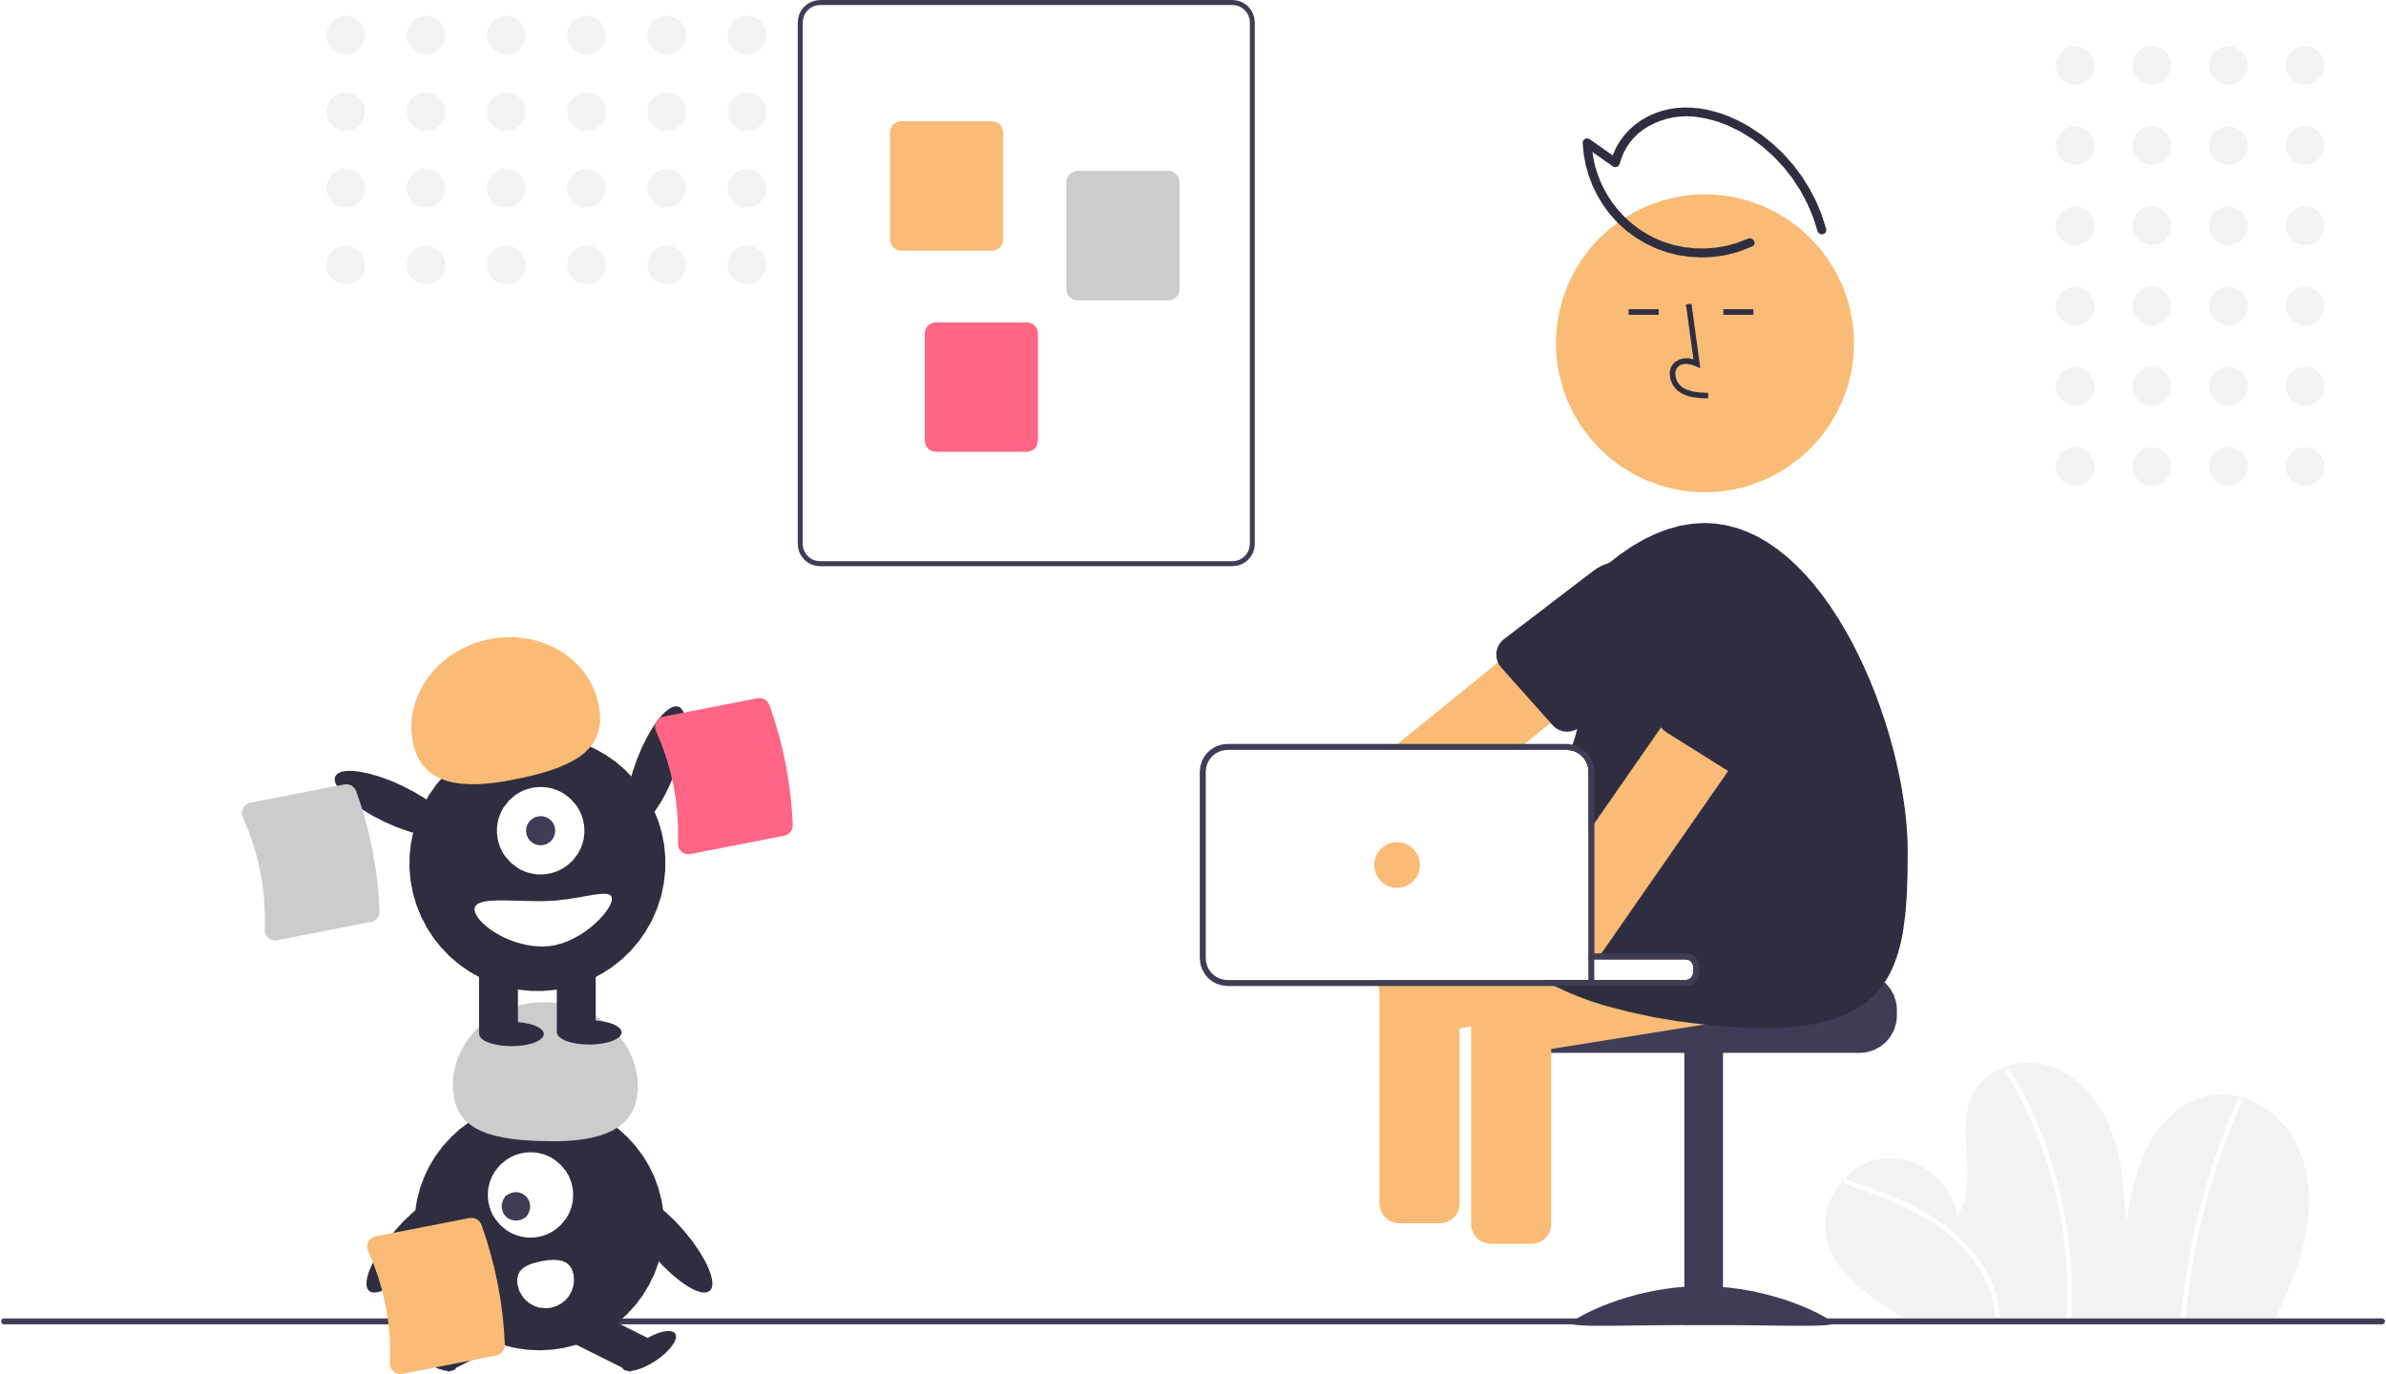
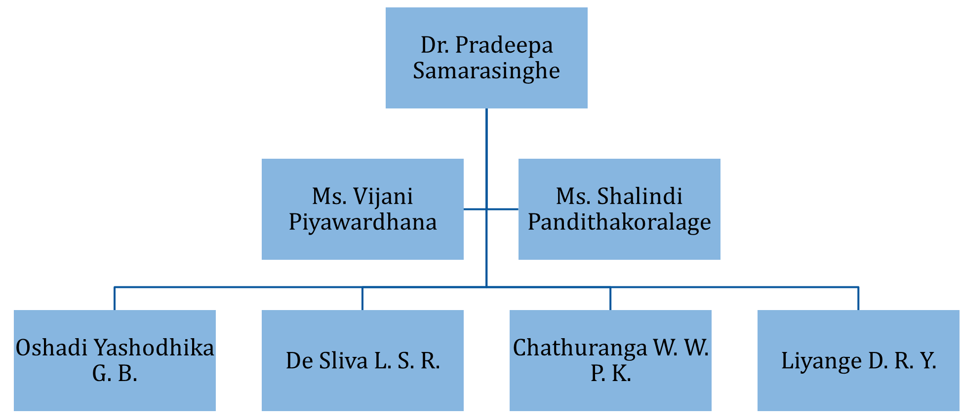

OUR TEAM

Slide 3

Depression ?
A recurrent mental disorder affecting more than 264 million people worldwide (World Health Organization).
Globally, depression has become the most common reason for illness and disability among adolescents
Early signs of severe depression are necessary to identify and ensure the affected person obtains immediate medical assistant.

Slide 4
Depression? (Cont’d)
Psychotherapy determines depression levels based on verbal reports that may bias the diverse aspects of individuals.
Currently, the mobile applications associated with depression use standard questionnaires and self assessment reports to evaluate the depression level.

Slide 5

Research Question
Why depression has become the most critical disorder?
People are not receiving adequate treatments, which may lead to suicide.
What is the main reason people tend to avoid treatment for depression in Sri Lanka?
In Sri Lanka, people may obscure the state of their minds due to social stigma and fear.

Slide 6
Research Question (Cont’d)
What is the primary concern of mental health providers?
Mental health providers have problems with monitoring of individuals for two weeks.
Why the industry need an automate solution to assess the depression?
Periodic assessment based on structured or unstructured clinical interviews may bias the different aspects of individuals.

Slide 7

Objectives
Emotion-based behavior analysis for early identification of depressive disorder.
social media content analysis for early identification of depressive disorder.
Develop a mobile application to identify behaviors that could be highly anticipated to contribute in depressive disorder.
Acquire invasive and non-invasive data analysis for early identification of depressive disorder.
Obtain phone activity usage data analysis for early identification of depressive disorder.

Slide 8
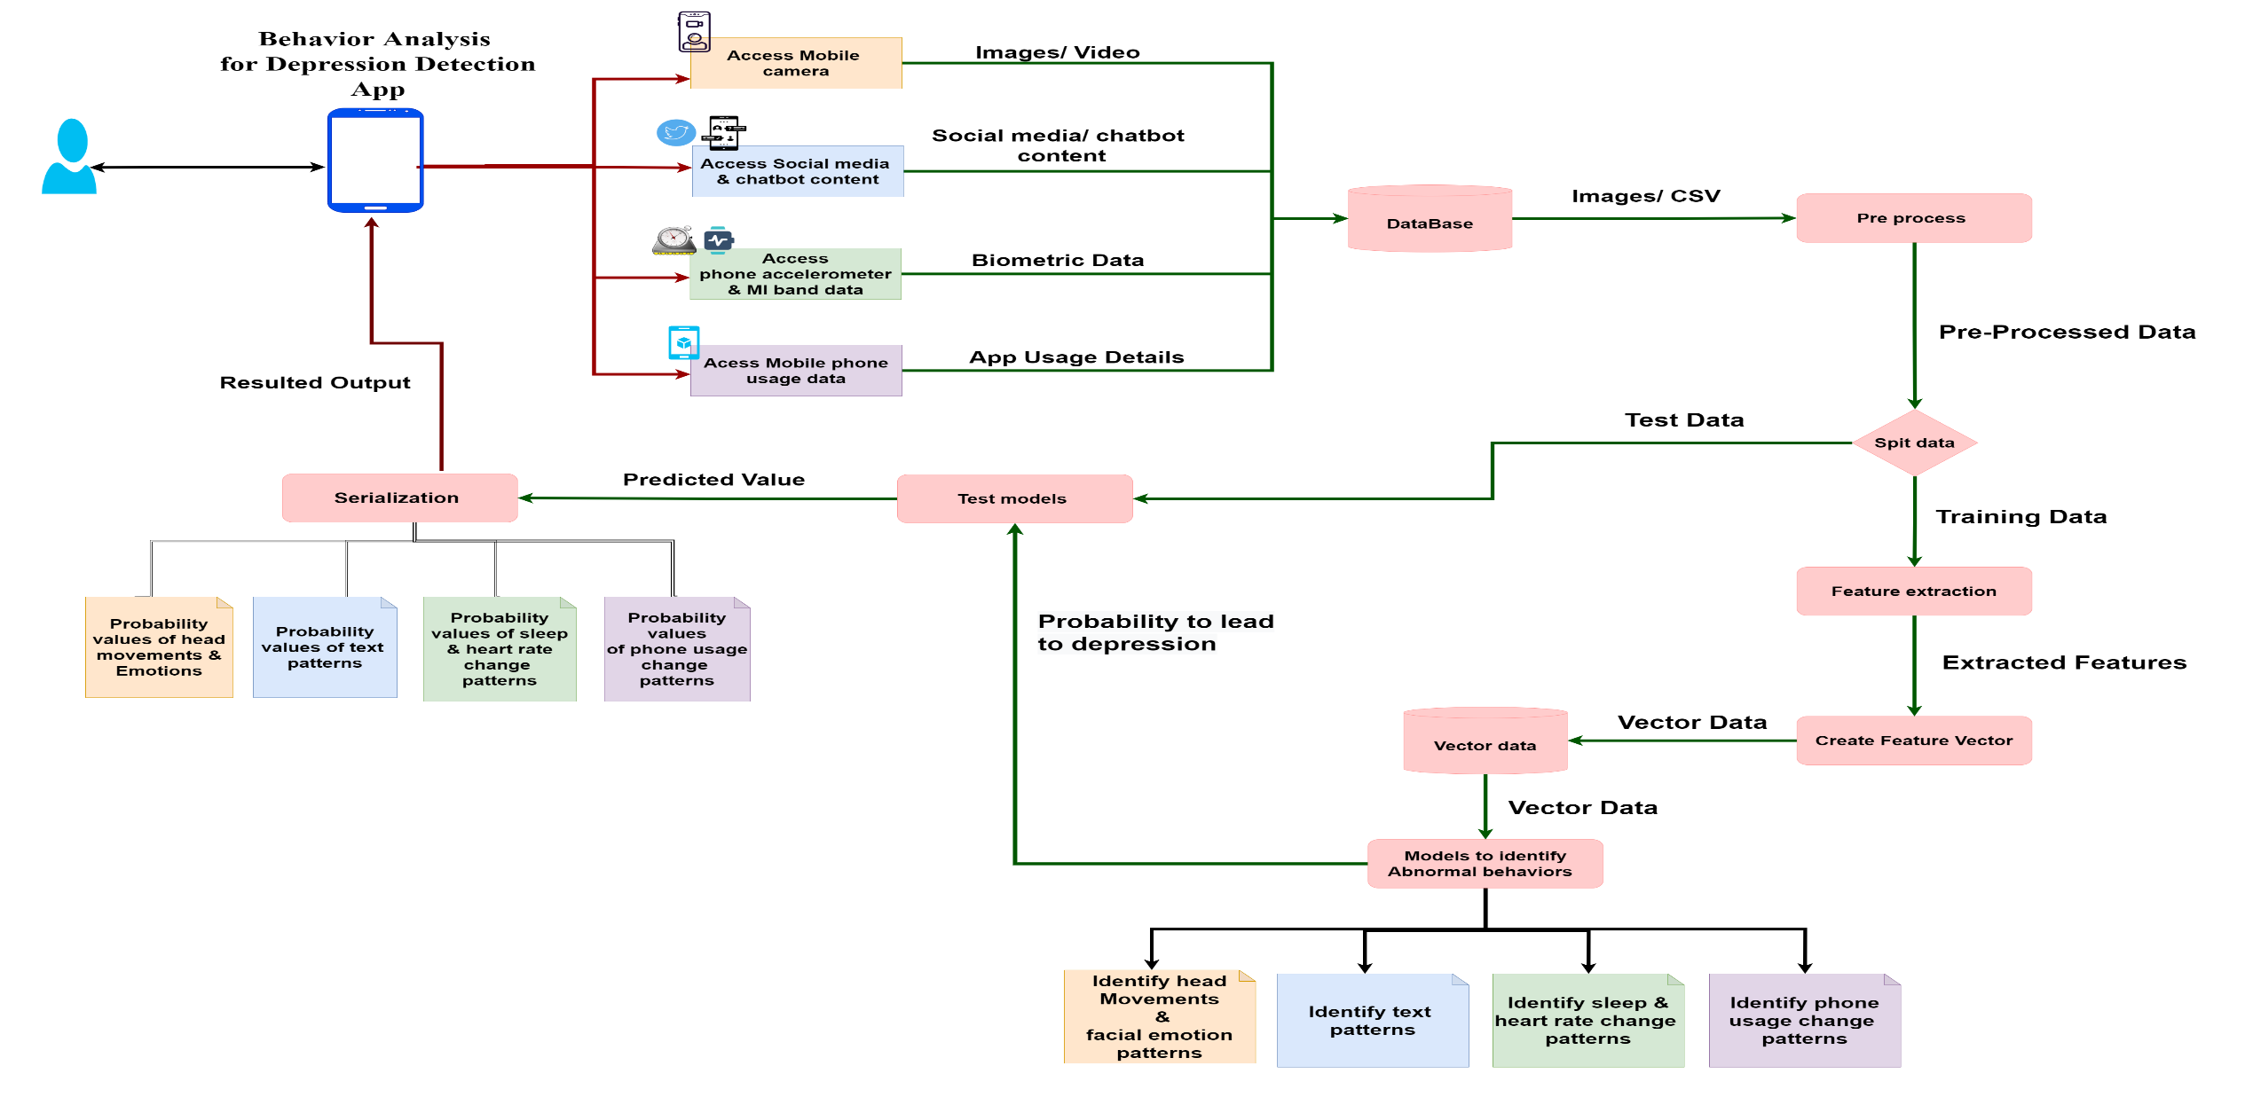
Overall System Diagram

Slide 9








Technologies, Techniques, Algorithms
Mobile App Development
Flutter
Dart
Development Language
Python
Database
Firebase
Environment / IDE
Anaconda 3
Visual Studio Code
Spyder

Slide 10
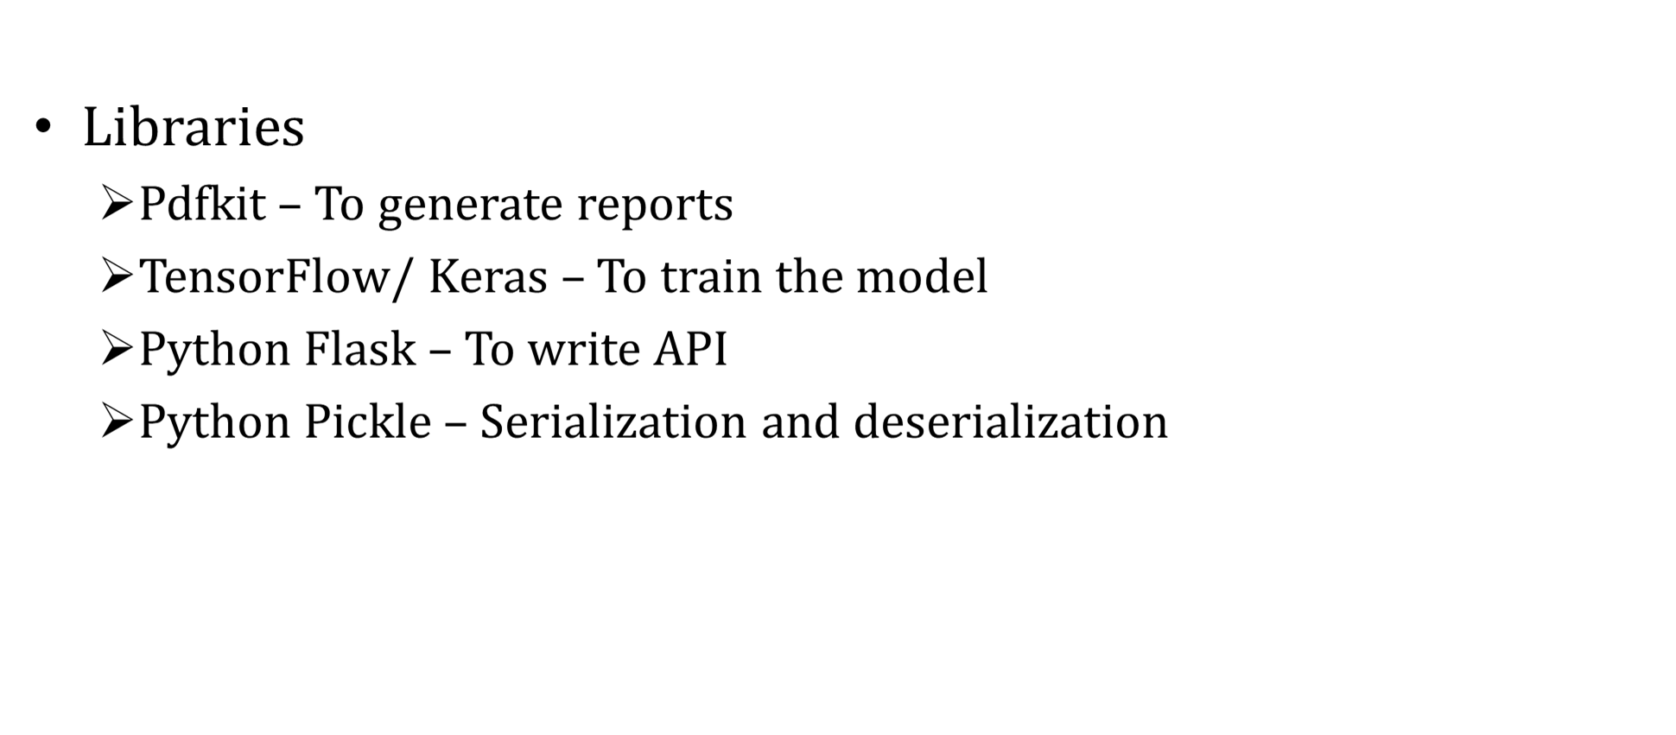
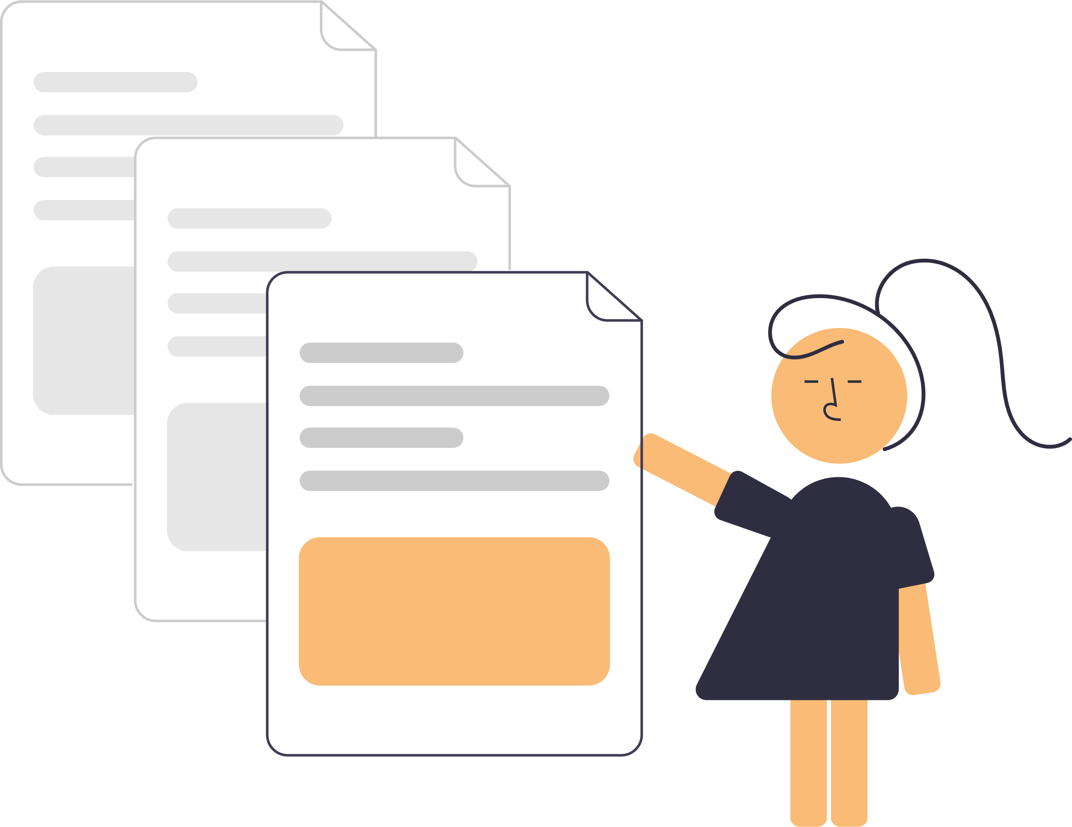
Technologies, Techniques, Algorithms (Cont’d)

Slide 11
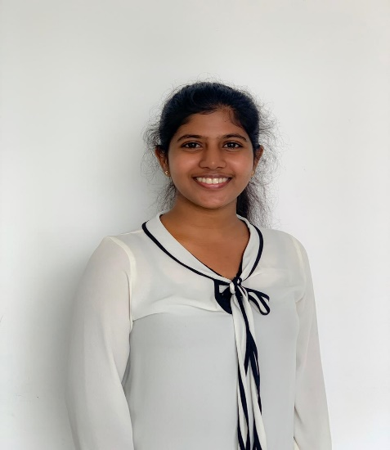

It18120226 | Oshadi Yashodhika g. b.
Information Technology
IT18120226 | Oshadi Yashodhika G. B. | 2021-073

Slide 12

EMOTION-BASED BEHAVIOR ANALYSIS FOR EARLY IDENTIFICATION OF DEPRESSIVE DISORDER
Background
Research Gap
Research Question
Specific and Sub Objectives
IT18120226 | Oshadi Yashodhika G. B. | 2021-073

Slide 13
Background
Facial and vocal behavior relation in diagnosing depression
First automated facial image analysis and audio signal processing by J. F. Cohn et al. [1].
Person-specific Active Appearance Model (AAMs), Manual Facial Action Coding System (FACS), and vocal prosody.
Detect depression among college students by considering frontal face images.
D. Venkataraman et al. considered frontal face images of happy, contempt, and disgust in the video frame [2].
The statical analysis on the head pose and movement patterns.
S. Alghowinem et al. examined the head pose and movement patterns of depressed individuals compared to healthy subjects using clinically validated real-world data [3].
IT18120226 | Oshadi Yashodhika G. B. | 2021-073

Slide 14
Background (Cont’d)
Feasibility of a cross-cultural method to assess depression severity
S. Alghowinem et al. considered temporal aspects of the eye gaze and head position of the participants by using video-recorded clinical interviews [4].
J. Joshi et al. explored the upper body movements and gestures for automatic depression analysis [5]
Upper body movements and intra-facial movements were computed using Space-Time Interest Points (STIP) feature.
head movement analysis was assessed by selecting rigid facial fiducial points.
IT18120226 | Oshadi Yashodhika G. B. | 2021-073

Slide 15
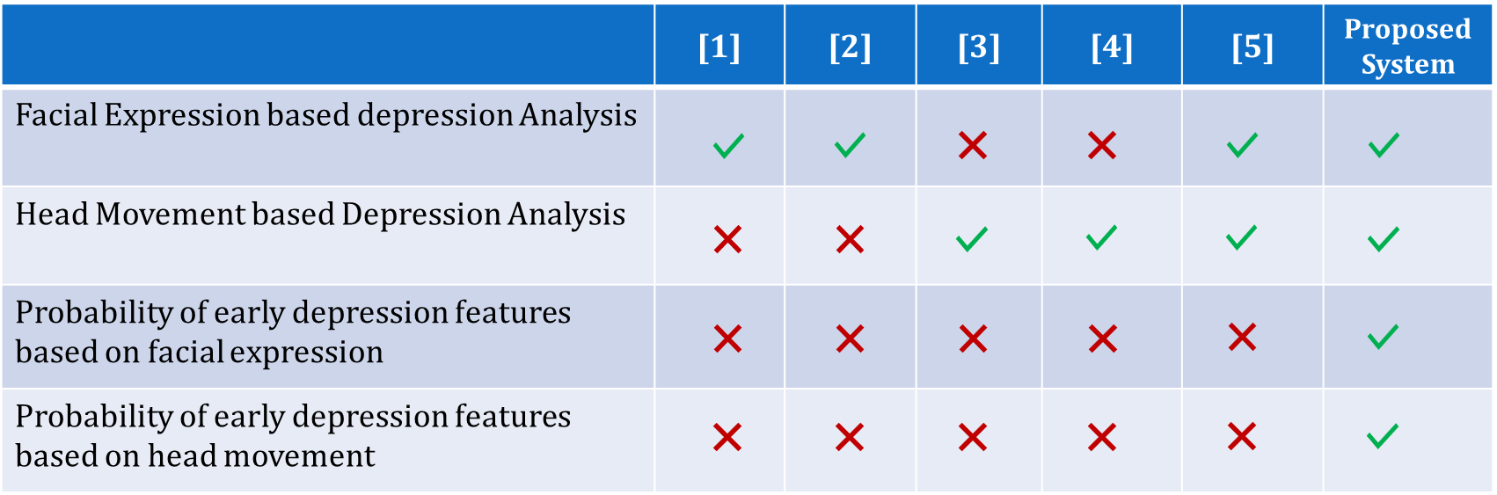
Research Gap
IT18120226 | Oshadi Yashodhika G. B. | 2021-073

Slide 16


Mobile Application Gap
 | MindDoc | IMood-Journal | Sanvello | UP! | Daylio Journal | Proposed App
Track emotion state
Identify real-time Emotion
Identify real-time Head Movement Pattern
Depression analysis based on emotion
Analyze mood
Notify care provider
Extensive Evaluation
IT18120226 | Oshadi Yashodhika G. B. | 2021-073

Slide 17
Research Question
Lack the automated solution to identify early depression symptoms using facial expression.
Lack the automated mechanism to identify head movement patterns of a depressed individual.
Behavior monitoring of individuals for two weeks is difficult.
Individuals do not attend counseling sessions due to social stigma.
IT18120226 | Oshadi Yashodhika G. B. | 2021-073

Slide 18



Specific and Sub Objectives
Specific Objective
Emotion-based behavior analysis for early identification of depressive disorder
Sub Objectives
Create datasets to retrieve facial emotions of depressed/likely depressed individuals.
Identify emotions of depressed/likely depressed individuals based on images and videos.
Improving the existing methods to capture subtle emotional changes.
Identify head movements pattern of depressed/likely depressed individuals based on videos.
Build a classifier to model, abnormal behaviors based on facial emotions and head movements.
Predict the probability of abnormal behavior towards depression with the designed model.
Integrate the classifier to Mobile Application.
IT18120226 | Oshadi Yashodhika G. B. | 2021-073

Slide 19


Research Methodology
System Diagram
Technologies, techniques, algorithms to be used
System, personnel, and software specification Requirements
Work Breakdown Structure
IT18120226 | Oshadi Yashodhika G. B. | 2021-073

Slide 20

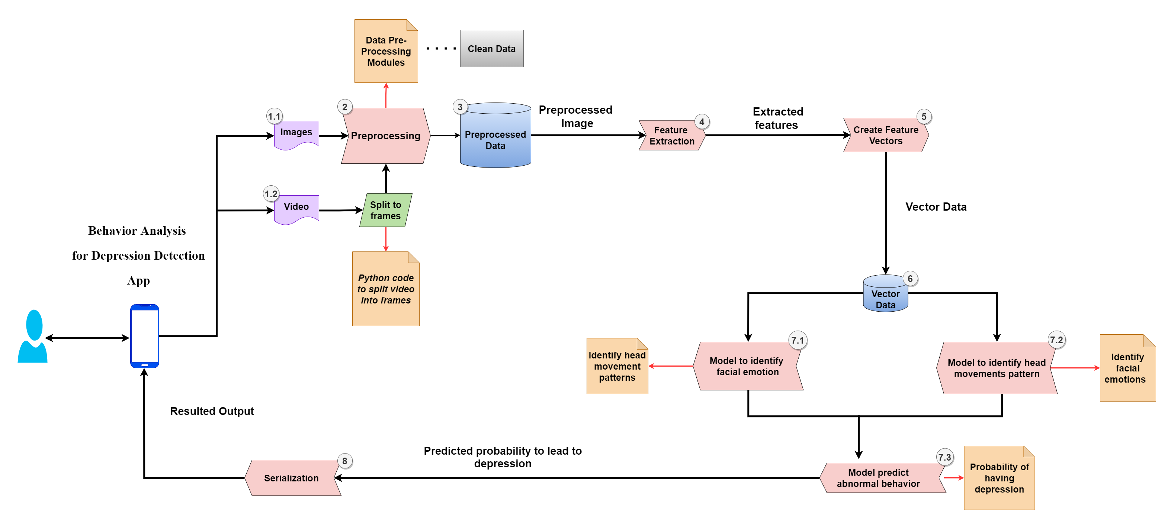
System Diagram
IT18120226 | Oshadi Yashodhika G. B. | 2021-073

Slide 21

Technologies, techniques, algorithms (cont’d)
Concepts
Image processing
Computer Vision
Machine learning
Deep learning
Classifiers
Support Vector Machine (SVM)
Neural Network (NN)
Decision Tree
Libraries
OpenCV
OpenPose
DeepFace
IT18120226 | Oshadi Yashodhika G. B. | 2021-073

Slide 22



Requirements
Functional Requirements
Analyze facial expressions to identify individuals with abnormal behaviors towards depression.
Analysis of head movement pattern of the individual with abnormal behaviors towards depression.
Predict the probability of having early depression symptoms based on analysis of the facial emotions and head movement pattern
Extensive report generation.
Notify the health care provider or guardian.
The application should track the emotion stat of a depressed or likely depressed individual.
IT18120226 | Oshadi Yashodhika G. B. | 2021-073

Slide 23


Requirements (Cont’d)
Non - Functional Requirements
Privacy.
Security.
Reliability.
IT18120226 | Oshadi Yashodhika G. B. | 2021-073

Slide 24
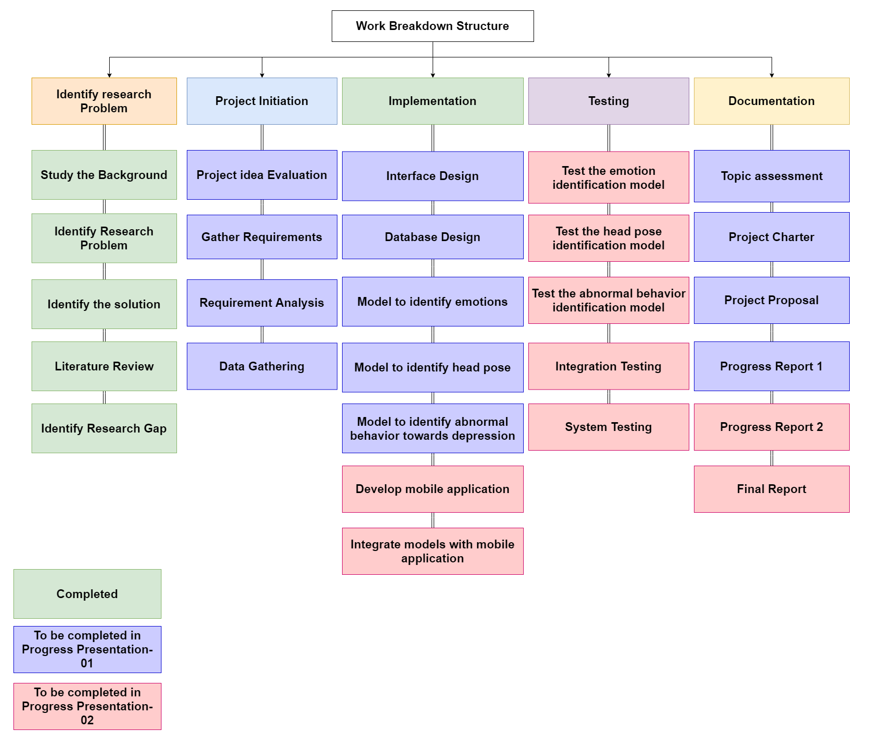
Work Breakdown Structure
IT18120226 | Oshadi Yashodhika G. B. | 2021-073

Slide 25
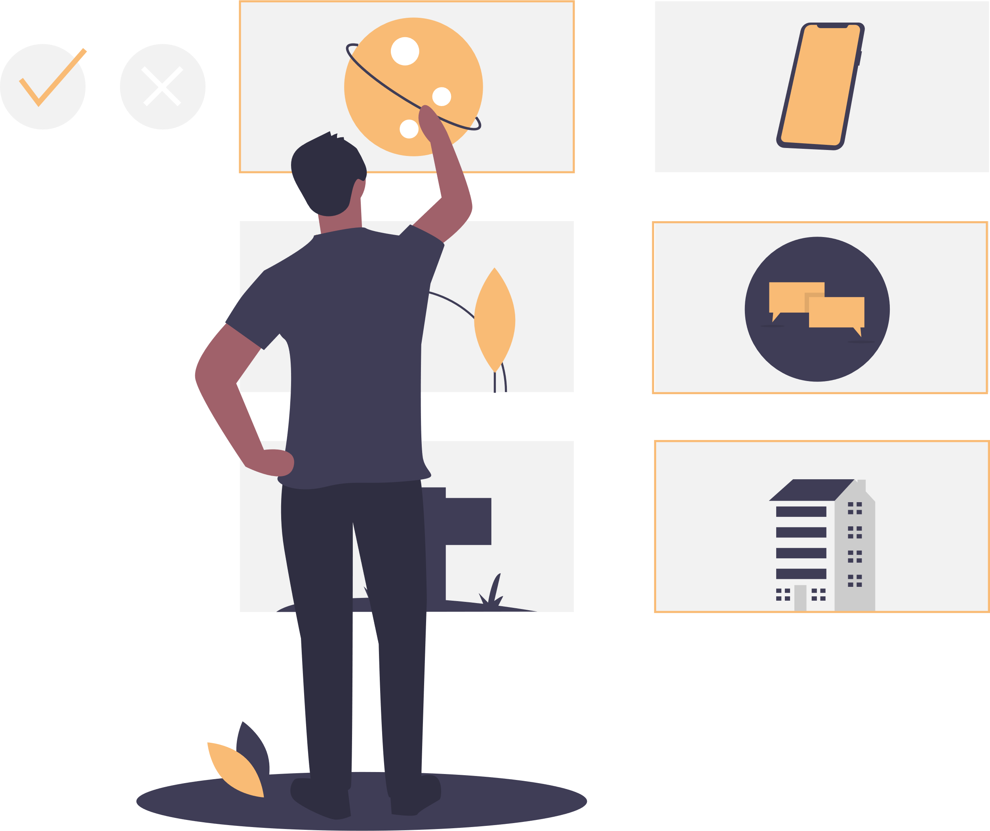
References
[1] J. F. Cohn, T. S. Kruez, I. Matthews, Y. Yang, M. H. Nguyen, M. T. Padilla, F. Zhou and F. De la Torre, "Detecting depression from facial actions and vocal prosody," 2009 3rd International Conference on Affective Computing and Intelligent Interaction and Workshops, 2009.
[2] V. D and S. P. Namboodiri, "A computer vision based image processing system for depression detection among students for counseling," Indonesian Journal of Electrical Engineering and Computer Science, vol. 14, no. 1, p. 503, 2019.
[3] S. Alghowinem, R. Goecke, M. Wagner, G. Parkerx and M. Breakspear, "Head Pose and Movement Analysis as an Indicator of Depression," 2013 Humaine Association Conference on Affective Computing and Intelligent Interaction, 2013.
[4] S. Alghowinem, R. Goecke, J. F. Cohn, M. Wagner, G. Parker and M. Breakspear, "Cross-cultural detection of depression from nonverbal behaviour," 2015 11th IEEE International Conference and Workshops on Automatic Face and Gesture Recognition (FG), 2015.
[5] J. Joshi, R. Goecke, G. Parker and M. Breakspear, "Can body expressions contribute to automatic depression analysis?" 2013 10th IEEE International Conference and Workshops on Automatic Face and Gesture Recognition (FG), 2013.
IT18120226 | Oshadi Yashodhika G. B. | 2021-073

Slide 26

IT18113914 |De silva l. s. r
Information Technology
IT18113914 | De Silva L. S. R. | 2021-073

Slide 27
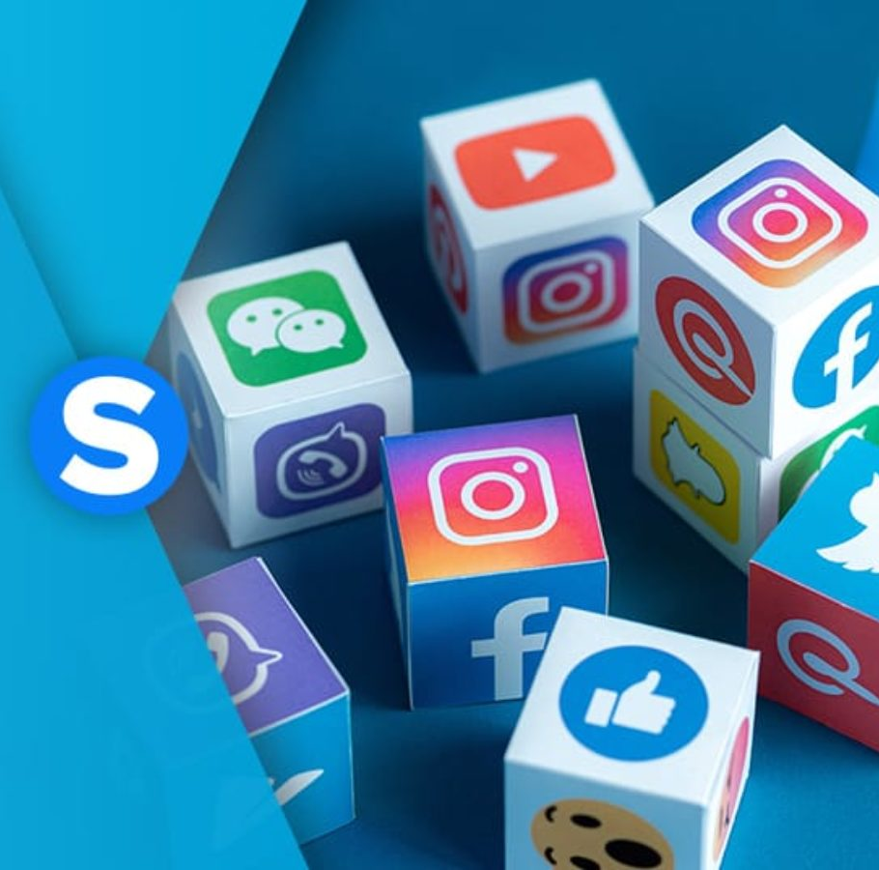
SOCIAL MEDIA CONTENT ANALYSIS FOR EARLY IDENTIFICATION OF DEPRESSIVE DISORDER
Background
Research Gap
Research Question
Specific and Sub Objectives
IT18113914 | De Silva L. S. R. | 2021-073

Slide 28
Background
A statistical model to estimate depression risk through the Twitter activities of the users
English-speaking Twitter users considered in the study of De Choudhury M et al. [2].
SVM classifier for behavioral cues (linguistic styles, depressive language, ego network, etc.) with an accuracy of approximately 70%.
A method to recognize depression using various features
Frequencies of word usage, the ratio of positive/ negative affect words, number of users following, number of users followed, etc.
Tsugawa et al. extended the [2] prediction framework to Japanese-speaking Twitter users.
IT18113914 | De Silva L. S. R. | 2021-073

Slide 29
Background (Cont’d)
A Chatbot to detect Depression.
Delahunty et. al developed a machine learning classifier to identify the depression level of the user [8].
A web application to analyze posts of Twitter users for detecting personal depression attitude using machine learning.
C. S. A. Raza et al. Three different techniques (Naive Bayes Classifier technique, NLP techniques, Deep Learning technique) to analyze depression risk by considering positive and negative tweets [3].
Analyze depression through the Facebook activities of the users.
Md. Rafiqul Islam et al. considered Facebook comments in predicting depression among Facebook users [4].
study observed the decision tree algorithm as the highest accuracy in emotional process and linguistic style comparing to other machine learning techniques (KNN, SVM, Ensemble).
IT18113914 | De Silva L. S. R. | 2021-073

Slide 30
Research Gap
 | [6] | [7] | [8] | [9] | [10] | Proposed System
Social Media Content based Depression Analysis
Chatbot conversation based Depression Analysis
Probability of early depression features based on social media content
Probability of early depression features based on Chatbot conversation
IT18113914 | De Silva L. S. R. | 2021-073

Slide 31
Mobile Application Gap
 | Happify | Wysa | Woebot | Youper | Proposed App
AI chatbot
Social Media content analysis
Emotion analysis based on conversation
Depression analysis based on conversation
Depression analysis based on social media content
Notify Guardian
Comprehensive report Summary
IT18113914 | De Silva L. S. R. | 2021-073

Slide 32
Research Question
Difficult to monitor individuals manually for two weeks.
Lack the automated solution to identify early depression symptoms using Social media platform.
Lack the automated solution to analyze conversations to identify early depression symptoms.
Social stigma hinders individuals for attending counseling sessions.
IT18113914 | De Silva L. S. R. | 2021-073

Slide 33
Specific and Sub Objectives
Specific Objective
Social media content analysis for early identification of depressive disorder
Sub Objectives
Build a database based on Social Media Content.
Identify social media texting patterns based on the built database.
Build a classifier to model, abnormal social activities based on social media content.
Predict the probability of abnormal social activities towards depression with the designed model.
Design and implement ChatBot to initiate conversations, identify depressive thoughts based on conversations.
IT18113914 | De Silva L. S. R. | 2021-073

Slide 34
Research Methodology
System Diagram
Technologies, techniques, algorithms to be used
System, personnel, and software specification Requirements
Work Breakdown Structure
IT18113914 | De Silva L. S. R. | 2021-073

Slide 35
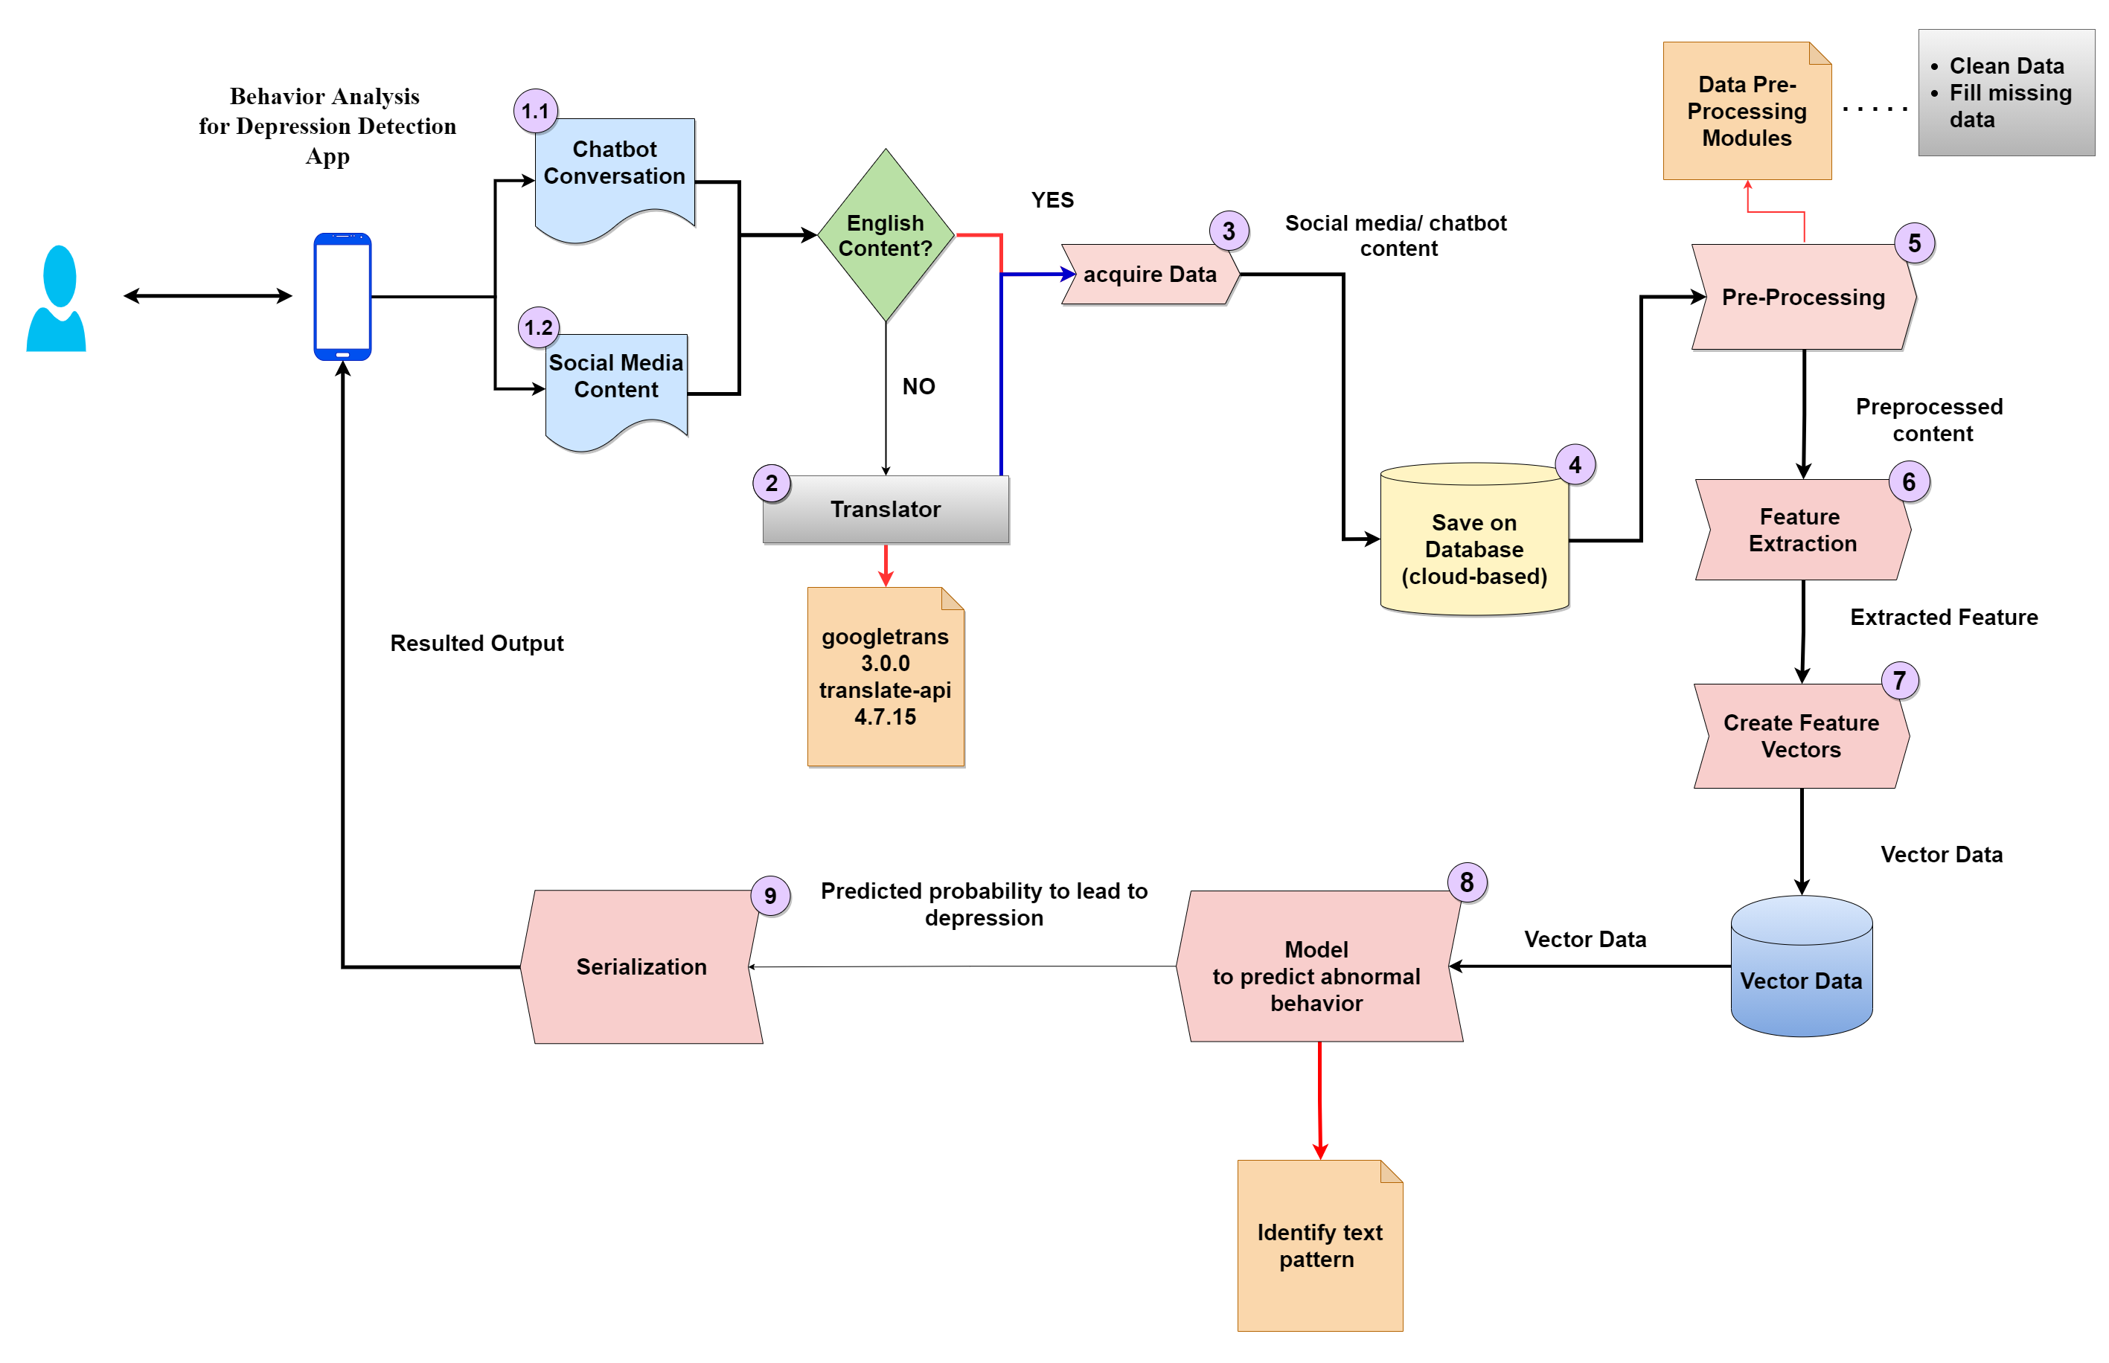
System Diagram
IT18113914 | De Silva L. S. R. | 2021-073

Slide 36
Technologies, techniques, algorithms (cont’d)
Concepts
Machine learning
Deep Learning
Natural Language Processing
Classifiers
Support Vector Machine (SVM)
Naïve Bayes
Random Forest
Decision Tree
Libraries
NLTK
SpaCy
IT18113914 | De Silva L. S. R. | 2021-073

Slide 37
Requirements
Functional Requirements
User should be able to chat with the application.
Analyze individual's conversation with the chatbot to identify individuals with abnormal social activities towards depression.
Social media content analysis to identify individuals with abnormal social activities towards depression.
Predict the probability of having early depression symptoms based on analysis of the social media content and conversation with the chatbot.
Generate the comprehensive report summary.
Notify the guardian or mental health care provider.
IT18113914 | De Silva L. S. R. | 2021-073

Slide 38
Requirements (Cont’d)
Non - Functional Requirements
Security.
Reliability.
Availability.
IT18113914 | De Silva L. S. R. | 2021-073

Slide 39
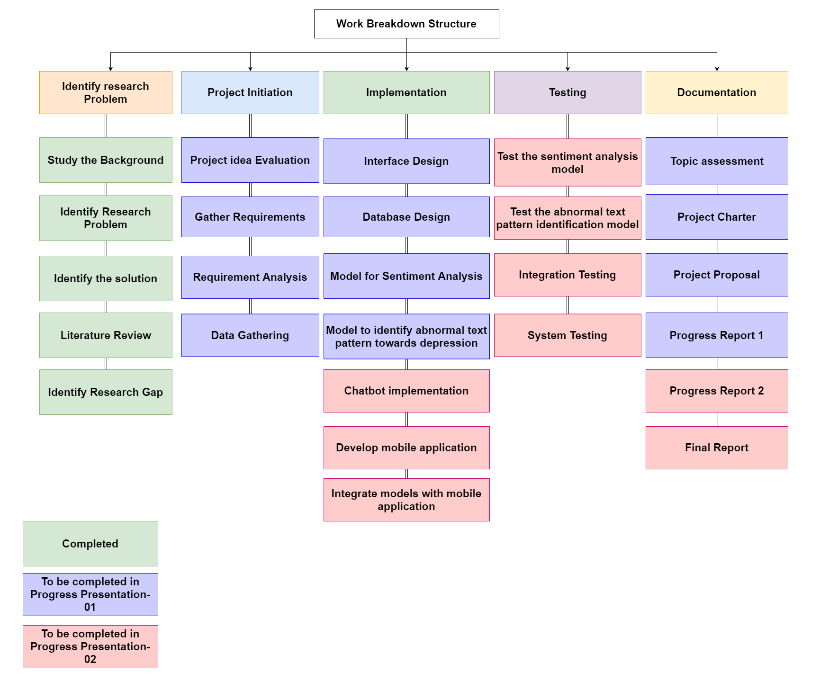
Work Breakdown Structure
IT18113914 | De Silva L. S. R. | 2021-073

Slide 40

References
[6] M. de Choudhury, M. Gamon, S. Counts and E. Horvitz, "Predicting Depression via Social Media," Seventh Int. AAAI Conf. Weblogs Soc., 01 July 2013.
[7] S. Tsugawa, Y. Kikuchi, F. Kishino, K. Nakajima, Y. Itoh and H. Ohsaki, "Recognizing Depression from Twitter Activity," Proceedings of the 33rd Annual ACM Conference on Human Factors in Computing Systems, 2015.
[8] C. S. A. Razak, M. A. Zulkarnain, S. H. A. Hamid, N. B. Anuar, M. Z. Jali and H. Meon, "Tweep: A System Development to Detect Depression in Twitter Posts," Lecture Notes in Electrical Engineering, pp. 543-552, 2020.
[9] M. R. Islam, M. A. Kabir, A. Ahmed, A. R. M. Kamal, H. Wang and A. Ulhaq, "Depression detection from social network data using machine learning techniques," Health Information Science and Systems, vol. 6, no. 1, 2018.
IT18113914 | De Silva L. S. R. | 2021-073

Slide 41
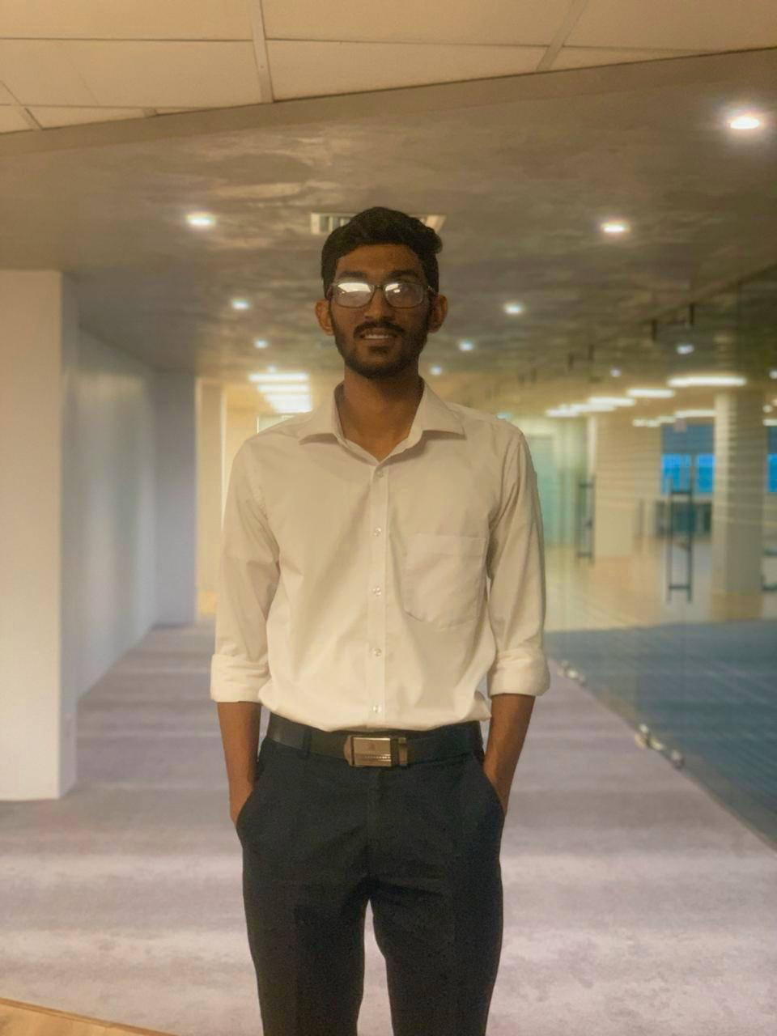
IT18119572 |ChathurAnga W.W.P.K
Information Technology
IT18119572 | Chathuranga W. W. P. K. | 2021-073

Slide 42
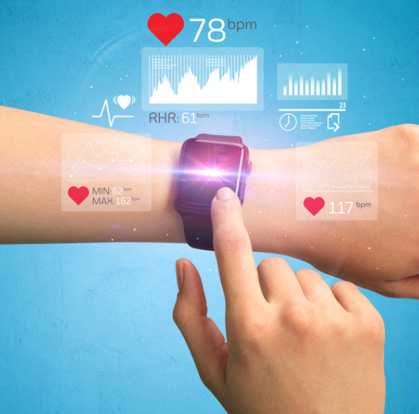
INVASIVE & NON – INVASIVE METHODS TO EARLY IDENTIFICATION OF DEPRESSIVE DISORDER
Background
Research Gap
Research Question
Specific and Sub Objectives
IT18119572 | Chathuranga W. W. P. K. | 2021-073

Slide 43
Background
Machine-learning algorithm to screen for depression and assess severity based on data from the wearable device .
The study conducted by Faculty of Science and Technology, Keio University, Kanagawa, Japan they have used Silmee W20 wristband biosensor device as wearable [10].
XGBoost was used to build machine learning models and 10-fold cross-validation was applied for the validation.
Tracking Depression Dynamics in College Students.
The research have conducted by Dartmouth College USA and Heart rate have collected using wearable called Microsoft Band [11].
“StudentLife” app have used to acquire sleep details and mobility.
IT18119572 | Chathuranga W. W. P. K. | 2021-073

Slide 44
Background (Cont’d)
Objective Assessment of Depressive Symptoms with Machine Learning and Wearable Sensors Data.
The study conducted by Media Lab, MIT, Cambridge, MA have predicted the Hamilton Depression Rating Scale (HDRS) [12].
In the study electrodermal activity (EDA), sleep behavior, motion, phone-based communication, location changes, and phone usage patterns have collected.
The data have acquire using E4 wearable wristbands and from sensors in an Android phone.
Predicting Symptoms of Depression
A study by Isaac Moshe et al has aimed to explore the extent to which data from smartphone and wearable devices could predict symptoms of depression and anxiety [13].
They have used wearable The Oura Ring which provides measurements related to sleep (total sleep time, sleep onset latency, wake after sleep onset, and time in bed) and heart rate variability (HRV).
research has proved significant positive associations between total sleep time and depression, time in bed, and depression.
IT18119572 | Chathuranga W. W. P. K. | 2021-073

Slide 45
Research Gap
 | [11] | [12] | [13] | [14] | Proposed System
Depression analysis base on biometrical parameter changes.
Screen and track depression using data that acquired using wearable
Explore which data can be collected using a wearable to predict depression.
Invasive method to acquire parameter data
Noninvasive method as an alternative to acquire same parameter data.
Probability of early depression analysis based on biometric data.
IT18119572 | Chathuranga W. W. P. K. | 2021-073

Slide 46
Mobile Application Gap
 | Sleepio | StressScan | Welltory | Mood path | Proposed App
Track most critical factors Biomatrix data
Invasive method to collect Factor’s data
Non- invasive method to collect Factor’s data
Depression analysis based on Biomatrix data (HRV, Sleep pattern)
Notify Guardian
Comprehensive report Summary
IT18119572 | Chathuranga W. W. P. K. | 2021-073

Slide 47
Research Question
Lack of the automated applications that focus on identify early depression disorder using biometric parameters.
Lack of systems that acquire data without the user’s contribution.
Difficulties of two weeks manual monitoring individuals.
The social impact that makes individuals avoid medication and understand symptoms.
IT18119572 | Chathuranga W. W. P. K. | 2021-073

Slide 48
Specific and Sub Objectives
Specific Objective
Acquire invasive and non-invasive data analysis for early identification
of depressive disorder.
Sub Objectives
Recognize health parameters that can be collected using a wearable device to identify early depression symptoms.
Identify techniques as alternative methods to collect the same parameter data.
Collect data using invasive (wearable) and non-invasive techniques and build methods to identify early depression symptoms
Predict the probability of abnormal physical changes towards depression with the designed models.
Integrate both models into the mobile app.
IT18119572 | Chathuranga W. W. P. K. | 2021-073

Slide 49
Research Methodology
System Diagram
Technologies, techniques, algorithms to be used
System, personnel, and software specification Requirements
Work Breakdown Structure
IT18119572 | Chathuranga W. W. P. K. | 2021-073

Slide 50
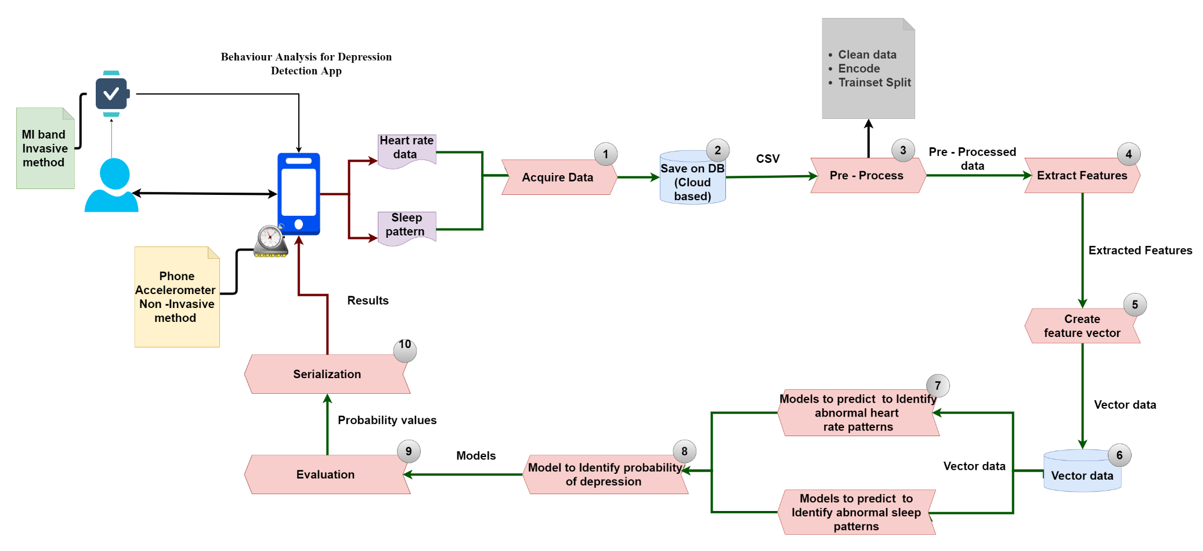
System Diagram
IT18119572 | Chathuranga W. W. P. K. | 2021-073

Slide 51
Technologies, techniques, algorithms (cont’d)
Concepts
Machine learning.
Classifiers
Support Vector Machine (SVM)
Binary Regression
K – Nearest Neighbors (k - NN)
Libraries
Scikit-Learn
Python Flask
Python Pickle
Packages
Python SleepPy
Dependencies
rawsensors: ^0.0.3
IT18119572 | Chathuranga W. W. P. K. | 2021-073

Slide 52
Requirements
Functional Requirements
Analysis biometrics parameter data to identify individuals with abnormal behavioral changes toward depression.
Predict the probability of having early depression symptoms based on analysis of biometric data gathering invasively & non-invasively.
The user should be able to connect warble to the mobile application.
Users must provide necessary notifications when accessing the phone sensors.
Users should be able to check a daily summary of biometric data that has been collected.
Notify the guardian or mental health care provider.
Generate the comprehensive report summary.
IT18119572 | Chathuranga W. W. P. K. | 2021-073

Slide 53
Requirements (Cont’d)
Non - Functional Requirements
Security.
Privacy.
Reliability.
Usability.
IT18119572 | Chathuranga W. W. P. K. | 2021-073

Slide 54
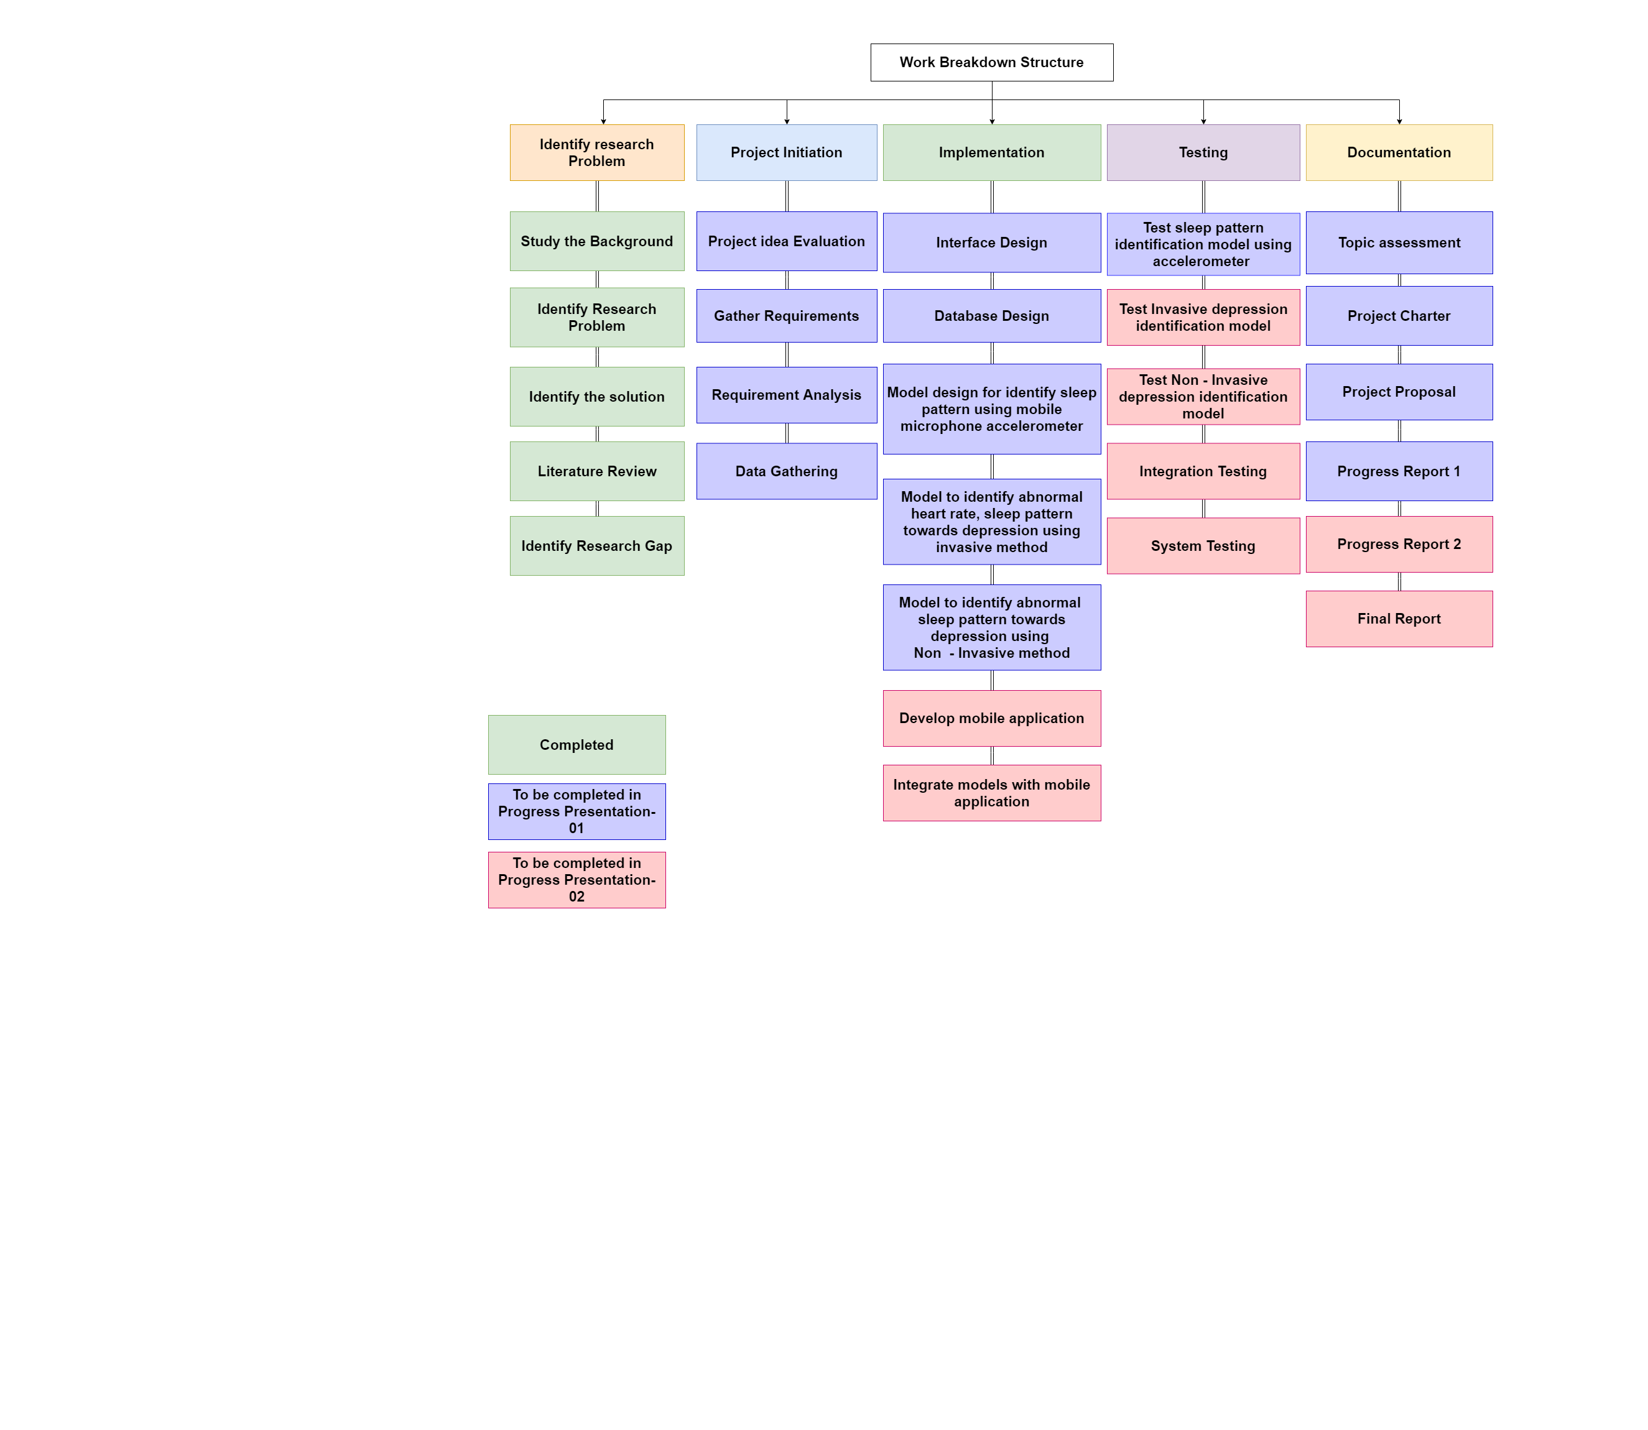
Work Breakdown Structure
IT18119572 | Chathuranga W. W. P. K. | 2021-073

Slide 55
References
[10] Y. Tazawa, K.-c. Liang, M. Yoshimura, M. Kitazawa, Y. Kaise and A. Takamiya, "Evaluating depression with multimodal wristband-type wearable device: screening and assessing patient severity utilizing machine-learning," Heliyon, vol. 6, no. 2, 2020.
[11] R. Wang, W. Wang, A. daSilva, J. F. Huckins, W. M. Kelley, T. F. Heatherton and A. T. Campbell, "Tracking Depression Dynamics in College Students Using Mobile Phone and Wearable Sensing," Proceedings of the ACM on Interactive, Mobile, Wearable and Ubiquitous Technologies, vol. 2, no. 1, pp. 1-26, 2018.
[12] Ghandeharioun†, S. Fedor†, L. Sangermano, D. Ionescu, J. Alpert, C. Dale, D. Sontag and R. Picard, "Objective Assessment of Depressive Symptoms with," 2017
[13] I. Moshe, Y. Terhorst, K. O. Asare, L. B. Sander, D. Ferreira, H. Baumeister, C. M. David and L. Pulkki-Råback , "Predicting Symptoms of Depression," january 2021
IT18119572 | Chathuranga W. W. P. K. | 2021-073

Slide 56

IT18119718 |Liyanage D.r.y
Information Technology
IT18119718 | Liyange D. R. Y. | 2021-073

Slide 57
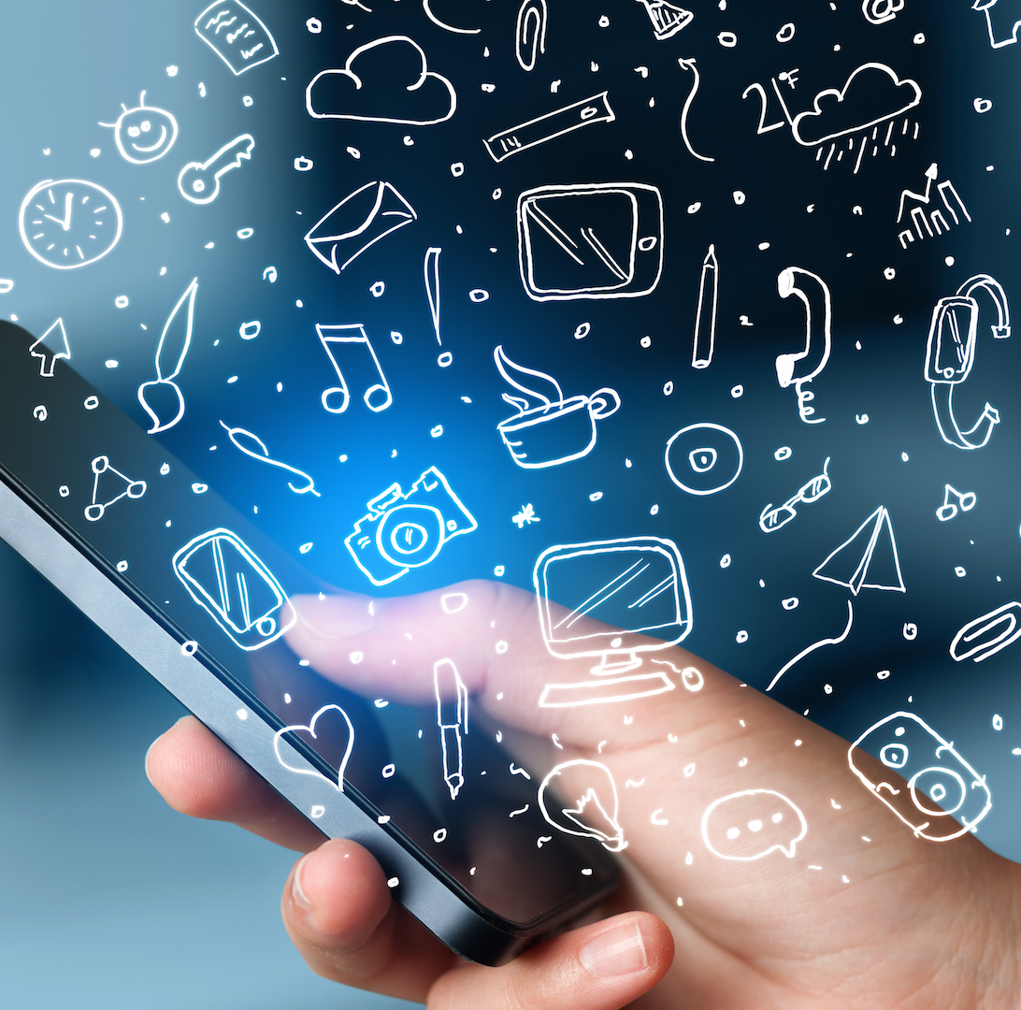
PHONE USAGE PATTERN ANALYSIS TO EARLY IDENTIFICATION OF DEPRESSIVE DISORDER
Background
Research Gap
Research Question
Specific and Sub Objectives
IT18119718 | Liyange D. R. Y. | 2021-073

Slide 58
Background
High phone usage among students and depression links together positively.
Studied by Kadir Demirci et al. “Relationship of smartphone use severity with sleep quality, depression, and anxiety in university students” [14].
The research “Relationship between the Manner of Mobile Phone Use and Depression, Anxiety, and Stress in University Students” by Aleksandar Višnjić, Vladica Veličković et al. [15].
The study by Sara Thomée et al. “Mobile phone use and stress, sleep disturbances, and symptoms of depression among young adults” [16].
Evaluate the relationship between the duration of time spent using the Internet for leisure and depressive symptoms.
The research have conducted by the School of Health and Social Development, Deakin University [17].
They have shown depressive symptoms were most frequent among higher users of the Internet (3 or more hours per day) among females only Compared to adolescents reporting Internet use for two hours or less.
IT18119718 | Liyange D. R. Y. | 2021-073

Slide 59
Background (Cont’d)
Addiction to social media can reflect suffering from depression disorder.
The study have conducted by Amit Chowdhry [18].
The study have proved compare to people who use social media less frequently participants that use social media very frequently have 2.7 times the likelihood of depression.
Track depression using Touchscreen typing pattern analysis.
A study by Rafail-Evangelos Mastoras1, Dimitrios Iakovakis1, et al [19].
They have used TypeOfMood app to collect the data to the analysis
IT18119718 | Liyange D. R. Y. | 2021-073

Slide 60
Research Gap
 | [15] [16] [17] | [18] | [19] | [20] | Proposed System
Depression analysis based on phone usage pattern.
Collect data without user contribution for the analysis.
Explore the key factors that links depresion.
Probability of early depression analysis based on phone usage pattern data.
IT18119718 | Liyange D. R. Y. | 2021-073

Slide 61
Mobile Application Gap
 | PROSIT | App Usage | TypeOf Mood app | Proposed App
Track parameters most related to depression
Collect data without user collaboration
Depression analysis based on Phone usage data
Notify Guardian
Comprehensive report Summary
IT18119718 | Liyange D. R. Y. | 2021-073

Slide 62
Research Question
Lack of the automated applications that focus on identify early depression disorder using Phone usage data.
Two-week manual monitoring of individual difficulty.
Lack of systems that acquire data without the user’s contribution.
Individuals tend to avoid medications due to the negative impact on society.
IT18119718 | Liyange D. R. Y. | 2021-073

Slide 63
Specific and Sub Objectives
Specific Objective
Identify the individuals that have a change in the lead to depression
disorder based on their phone usage pattern changes.
Sub Objectives
Recognize the key factors of phone usage to identify depressive disorder changes.
Build a service to run in the mobile in order to log the key factor’s data.
Based on data build a classifier to model, abnormal phone use based on mobile phone usage
Predict the probability of abnormal phone use towards depression with the designed model.
Integrate the classifier to the mobile app
IT18119718 | Liyange D. R. Y. | 2021-073
IT18119718 | Liyange D. R. Y. | 2021-073

Slide 64
Research Methodology
System Diagram
Technologies, techniques, algorithms to be used
System, personnel, and software specification Requirements
Work Breakdown Structure
IT18119718 | Liyange D. R. Y. | 2021-073
IT18119718 | Liyange D. R. Y. | 2021-073

Slide 65
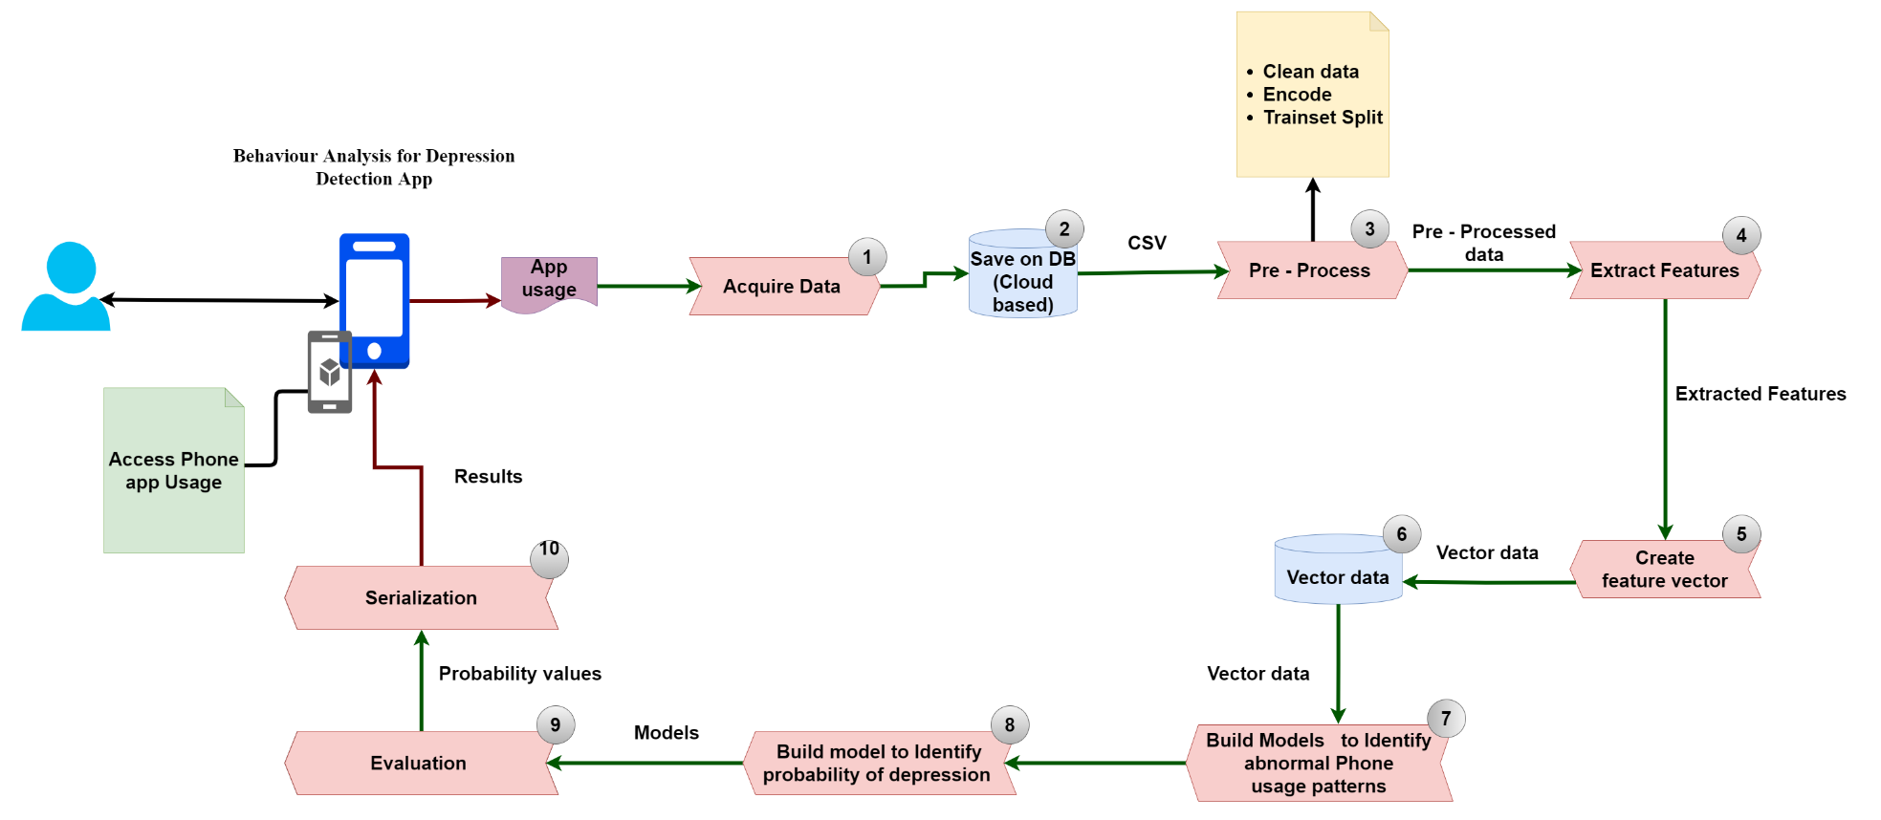
System Diagram
Model to identify probability of depression
Model to identify abnormal phone usage patterns
IT18119718 | Liyange D. R. Y. | 2021-073
IT18119718 | Liyange D. R. Y. | 2021-073

Slide 66
Technologies, techniques, algorithms (cont’d)
Concepts
Machine learning.
Classifiers
Support Vector Machine (SVM)
Random Forest
Decision Tree
ZoroR
K – Nearest Neighbors (k - NN)
Adaptive Boost
Libraries
Pdfkit
Scikit-Learn
Python Flask
Python Pickle
Flutter Dependencies
usage_stats 0.1.0
device_apps 1.2.0
app_usage 1.2.0
IT18119718 | Liyange D. R. Y. | 2021-073
IT18119718 | Liyange D. R. Y. | 2021-073

Slide 67
Requirements
Functional Requirements
Analysis of individual’s phone usage data to identify individuals with abnormal behavioral changes toward depression.
Predict the probability of having early depression symptoms based on analysis of phone usage data collected through the app.
Users should be able to check a daily summary of His/her daily usage of phone usage.
Users must provide necessary notifications when accessing the phone data.
Generate the comprehensive report summary.
Notify the guardian or mental health care provider.
IT18119718 | Liyange D. R. Y. | 2021-073
IT18119718 | Liyange D. R. Y. | 2021-073

Slide 68
Requirements (Cont’d)
Non - Functional Requirements
Security.
Privacy.
Reliability.
Availability.
IT18119718 | Liyange D. R. Y. | 2021-073

Slide 69
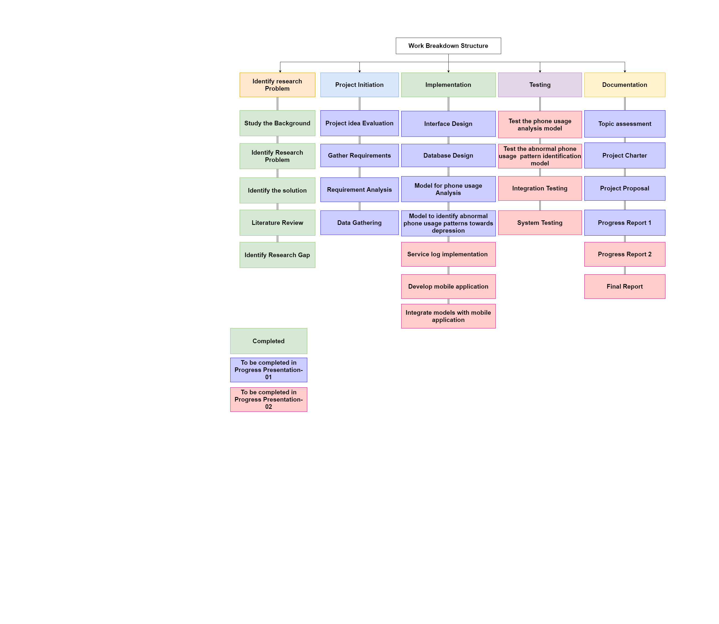
Work Breakdown Structure
IT18119718 | Liyange D. R. Y. | 2021-073

Slide 70
References
[14] K. Demirci, M. Akgönül and A. Akpinar, "Relationship of smartphone use severity with sleep quality, depression, and anxiety in university students," Journal of Behavioral Addictions, vol. 4, no. 2, pp. 85-92, 2015.
[15] A. Višnjić, V. Veličković, D. Sokolović, M. Stanković, K. Mijatović, M. Stojanović, Z. Milošević and O. Radulović, "Relationship between the Manner of Mobile Phone Use and Depression, Anxiety, and Stress in University Students," International Journal of Environmental Research and Public Health, vol. 15, no. 4, p. 697, 2015.
[16] S. Thomée, A. Härenstam and M. Hagberg, "Mobile phone use and stress, sleep disturbances, and symptoms of depression among young adults - a prospective cohort study," 2020.
[17] E. Hoare, K. Milton, C. Foster and S. Allender, "Depression, psychological distress and Internet use among community-based Australian adolescents: a cross-sectional study," BMC Public Health, vol. 17, no. 1, 2017.
[18] Chowdhry , "Research Links Heavy Facebook And Social Media Usage To Depression," 2017.
[19] R.-E. Mastoras, D. Iakovakis, S. Hadjidimitriou, V. Charisis, S. Kassie, T. Alsaadi, A. Khandoker and L. J. Hadjileontiadis, "Touchscreen typing pattern analysis for remote detection of the depressive tendency," Scientific Reports, no. 1, 2019.
IT18119718 | Liyange D. R. Y. | 2021-073

Slide 71
Commercialization for Proposed System
How proposed system addresses identified concerns?
Community value.
Business plan.
Overall budget.

Slide 72
How proposed system address the identified concerns?
Concern | Solution
In Sri Lanka, people may obscure the state of their minds due to social stigma and fear. | Self awareness app that users can understand about their mental status
Mental health providers have problems with monitoring of individuals for two weeks. | Summary of two weeks behavioral analysis notify user’s status.
Periodic assessment based on structured or unstructured clinical interviews may bias the different aspects of individuals. | Analysis of user behavioral changes without user contribution.
People are not receiving adequate treatments, which may lead to suicide. | User’s mental health status is sharing with user’s guardian or Mental health providers.

Slide 73

Community Value
Benefits to the public
Get mental health status without warring about appointments .
A spanned evaluation of behavioral changes without user contribution.
Two weeks behavioral analysis without user contribution.
Automated notifications system to notify guardian or health provider about individuals’ behavioral analysis.

Slide 74

Community Value (Cont’d)
Benefits to the Mental Healthcare Provider
Two weeks of the individual behavioral monitoring.
Notification about an individual's mental health level.
Help to start immediate medication as soon as the analysis completion.
Comprehensive report regarding user's abnormal behaviors toward depression.

Slide 75

Business model
The mobile application will be available for the users in google play store for free installation.
Wearable should be purchased by the users.

Slide 76
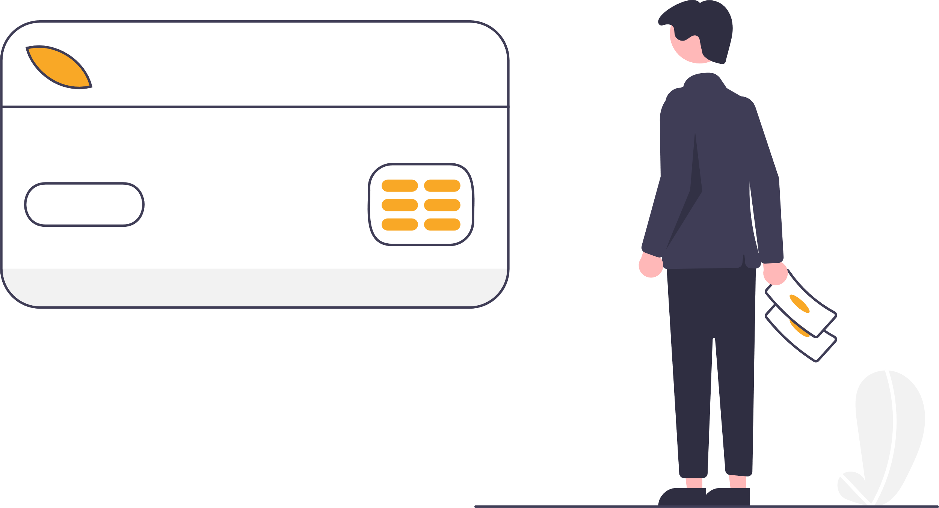

Overall budget
Event | $Cost (Rs)
MI band wristwatch | $30 – 32 (Rs. 6000 – 6250)
Create Play Store account to deploy the app | $25 (Rs.4875)
TOTAL | $57 (Rs. 11,115)

Slide 78



